Slide 1
A Community Governance Model for mobile and communicating Agents
Ben Koo
benkoo@tsinghua.edu.cn
April 14th，2020
Notes:
今天的主题是“区块链启发的新产业范式”

Slide 2
Top Level Outline
Governing “free-will agents” being the Ultimate Challenge in Strategizing Global Innovation
Governance Model for Communities of Agents
Strategies in terms of Architectural Patterns

Slide 3
Agents with Free Will?
Maxwell’s Demon as a model
Knows BOTH about the “Macro and Micro scopes” of the system
Is a way to link physical world with the information world
The Demon (agent) is extensible to represent any amount of intelligence

Slide 4
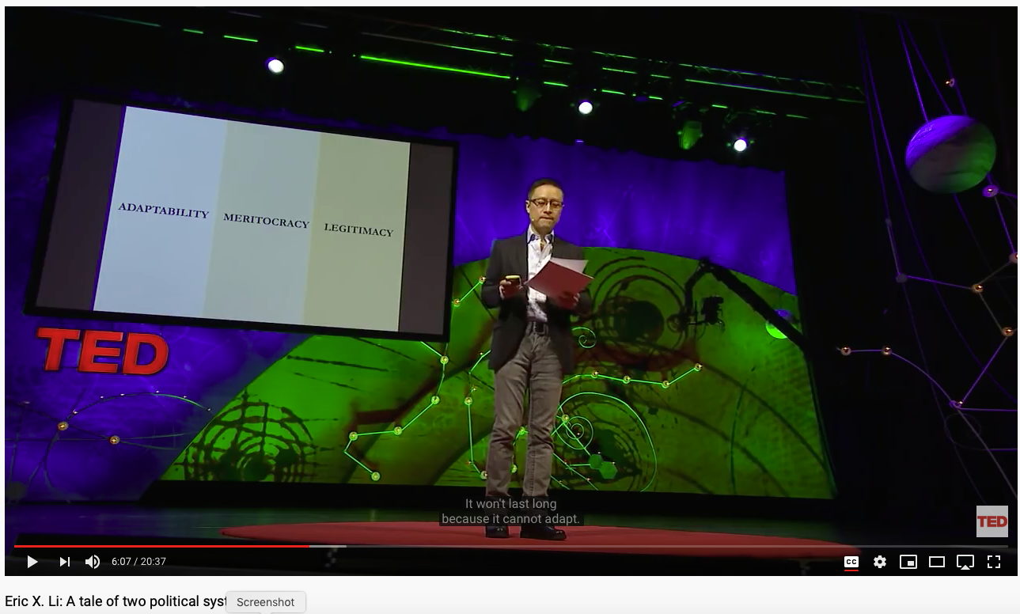
Pick a Community that governs the agents

Slide 5
The Social Contract as an Interface
Agent-based Modeling Forms
Objectives (Abstraction)
Key Results
(Concretization)

Slide 6
Bi-graph and Pi-Calculus

Slide 7
Communication and Computation

Slide 8
Integrated Tools

Slide 9
Architectural Elements
Kuhn Cycle being the Generic Workflow
Physics-based (consistent spacetime representation)
One Universal Accounting Ledger
Compositional Language (Pi-Calculus) integrated with Modern ICT
The ICT-enabled Workflow should be able to autonomously evolve (exercise free will)
Learning and Production

